Slide 1
Ames Microgrid Evaluation & Substation Consulting
sdmay25-02
Sean Carver, Bethany Danley, Thomas Edwards, Nathan Kallal, Mina Khalil, MacKenzie Woods
Notes:
Sean

Slide 2
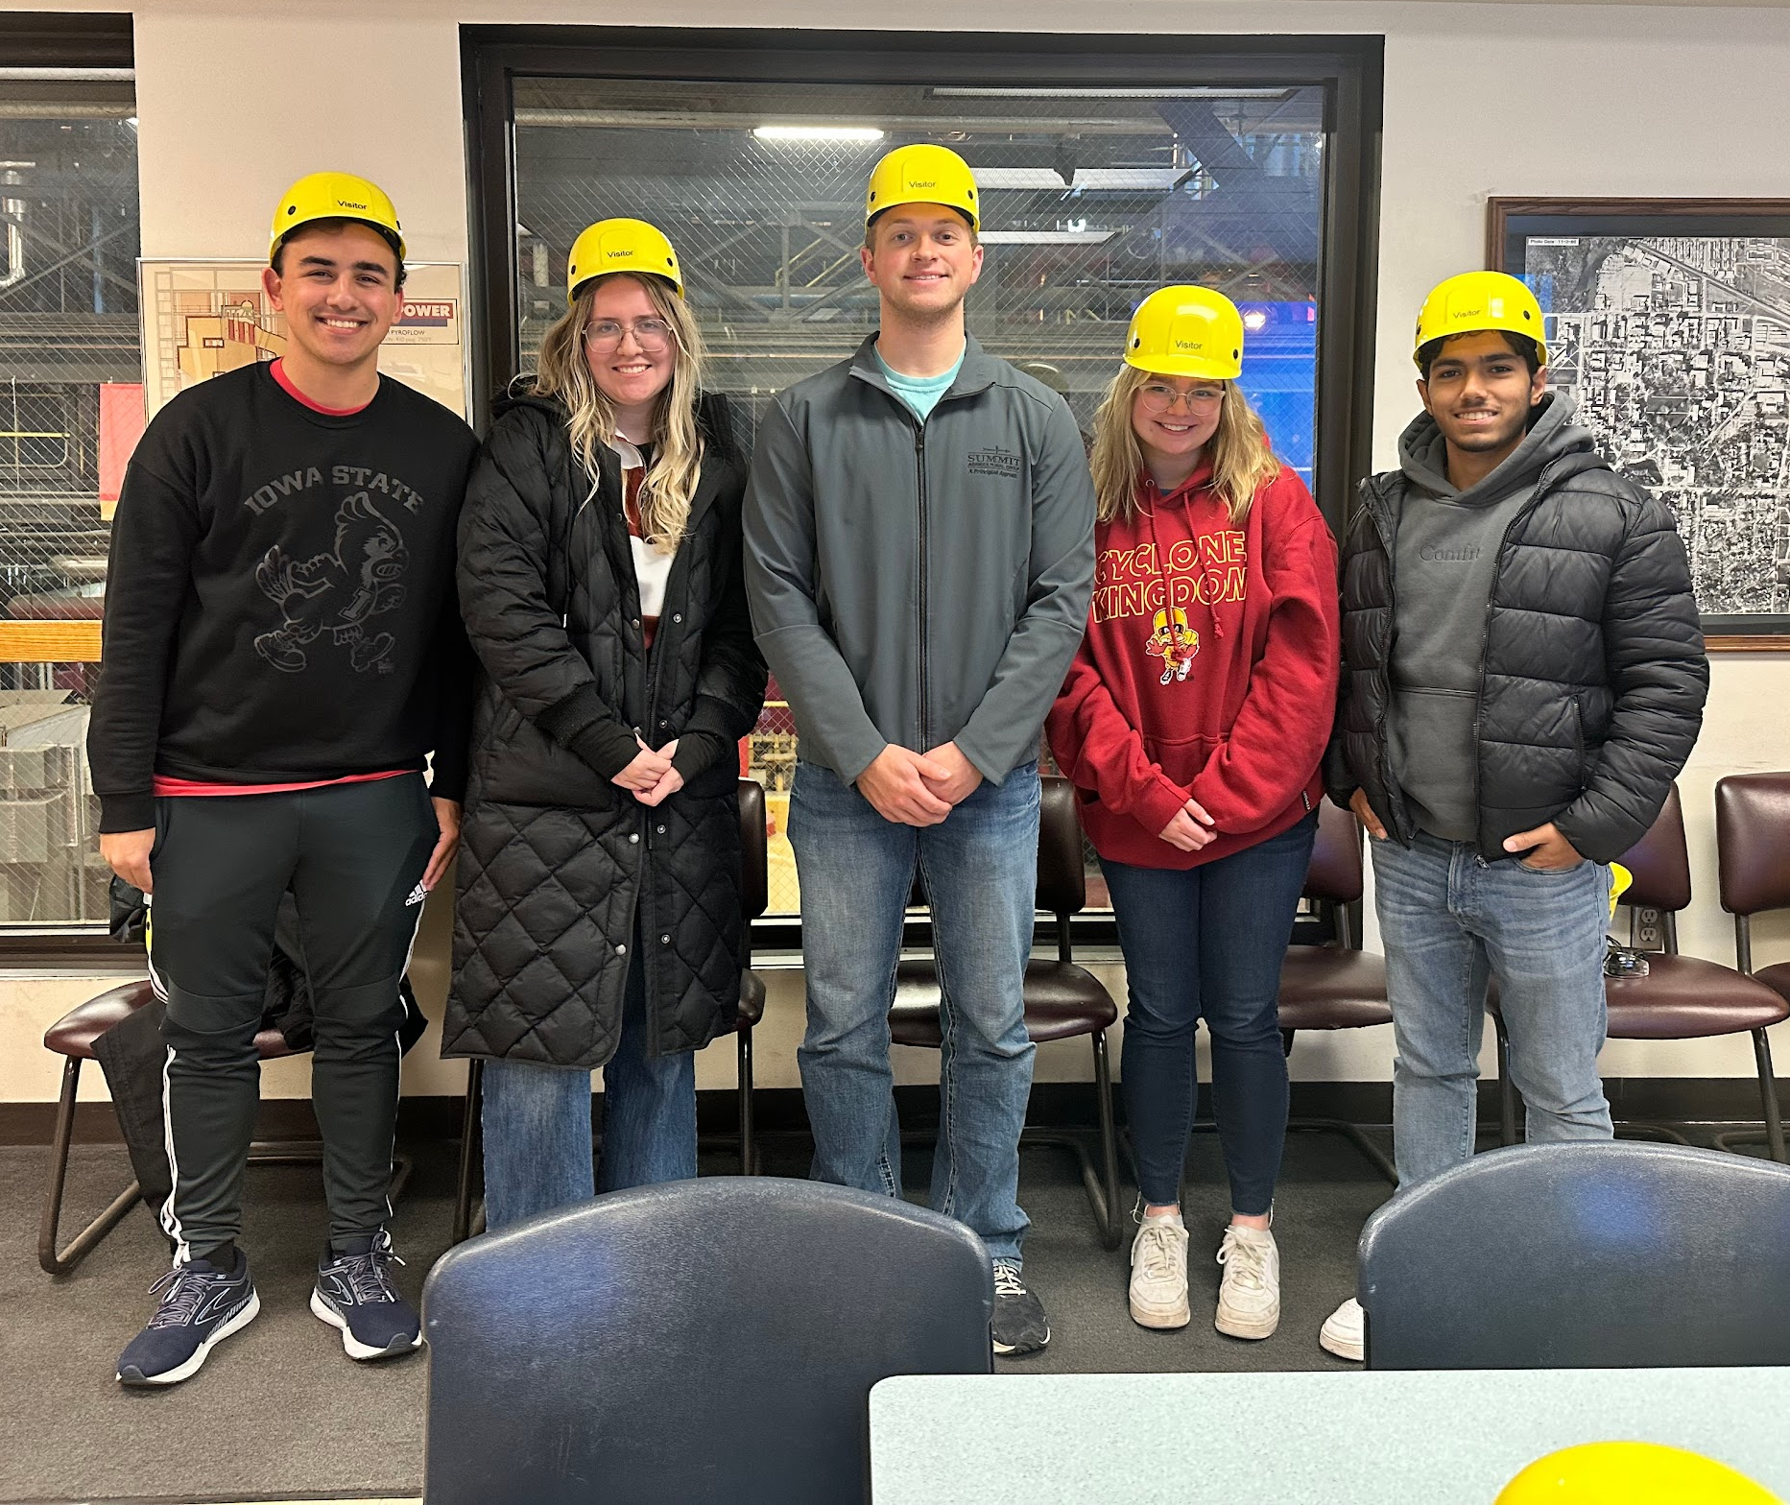
Team Members & Roles
Sean Carver - Substation Team
Bethany Danley - Distribution Team
Thomas Edwards - Distribution Team
Nathan Kallal - Distribution Team
Mina Khalil - Substation Team
MacKenzie Woods - Substation Team
Notes:
Everyone

Slide 3
Project Overview
Client: Burns & McDonnell
Faculty Advisor: Zhaoyu Wang
User: ISU Utilities and Customers
Goals:
Improve campus microgrid and substation infrastructure
Create scalable models for distribution and transmission
Objectives:
Develop a conceptual design package for a safe, reliable substation
Build a microgrid model for load management and energy distribution and implement contingency plans
Support growth and resilience with renewables
Notes:
Nathan

Slide 4
Client Information
Burns & McDonnell:
Engineer, Procure, Construct Company
Presence in the Power Generation & Transmission Fields
Client works in Transmission & Distribution department (Substation aspect)
1898 & Co.:
Consulting Arm of Burns & McDonnell
Client works in Distribution Consulting department (Distribution aspect)
Notes:
Thomas

Slide 5
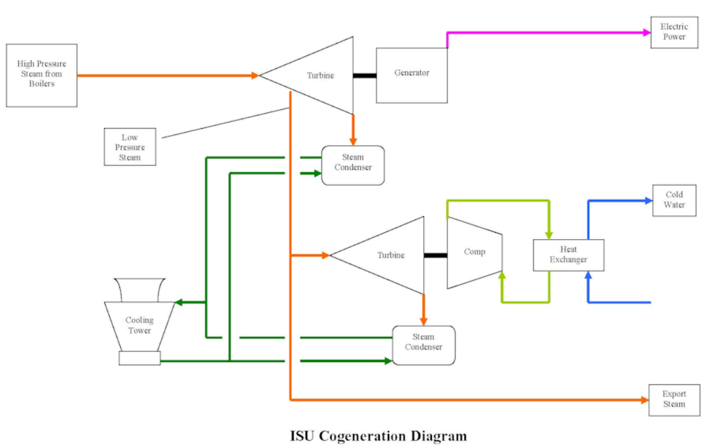
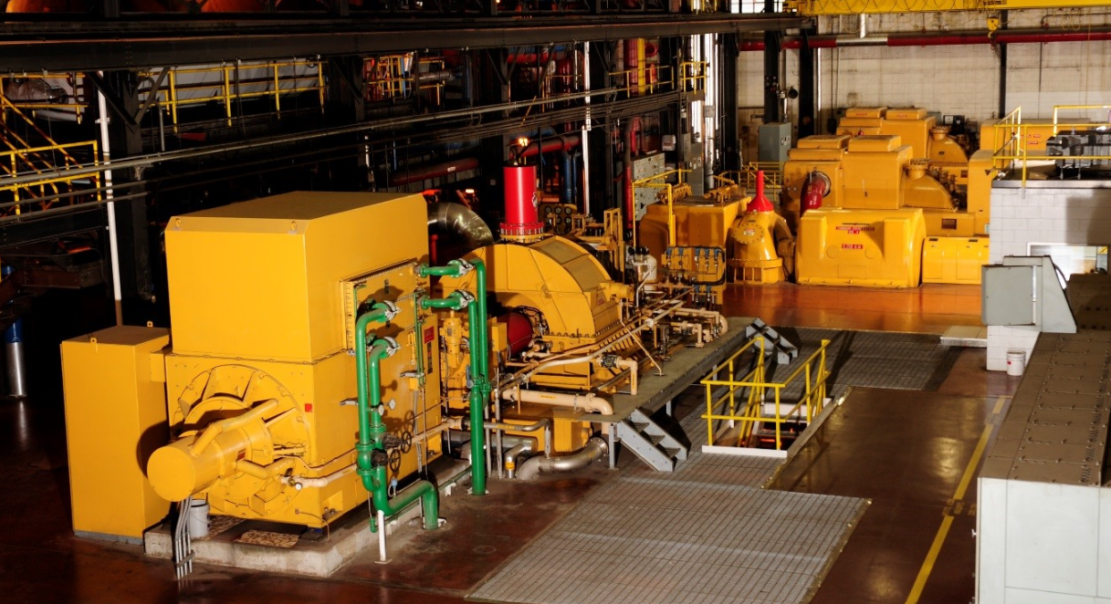
Current System
Specifications:
Power provided by ISU power plant and MISO
One 69/13.8kV substation on Haber Rd.
Distribution ring powers buildings
Switchgear operated at ISU power plant
Campus buildings consume an average of 20MW
Notes:
Sean

Slide 6
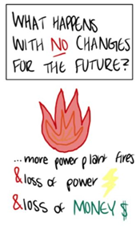
Problem Statement
Task:
Evaluate and model the electric distribution microgrid
Design for a new substation with battery integration
Objective:
Provide a comprehensive model for both the distribution grid and substation
Deliverables:
Create detailed documents outlining the evidence and data supporting the upgrade plans and models
Goal:
Ensure microgrid and substation reliability and scalability to meet future campus needs
Notes:
Nathan

Slide 7
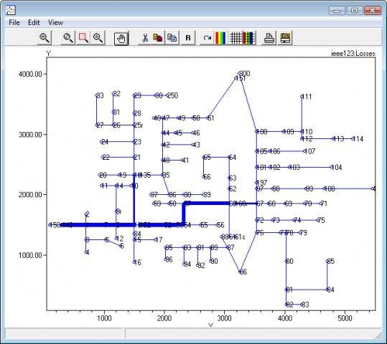
Requirements
Easy to Understand Models/Diagrams
OpenDSS Distribution Grid Model
AutoCAD Electrical Substation Model
All representations of our system upgrades should be easily to comprehend in deliverables
Research/Calculations Documents
Loading calculations and power flow documents/spreadsheets front the distribution team
Grounding study, fault current calculations for the substation team
Cost Estimates
Show the cost of each proposed upgrade & Bill of Materials for new resources
Notes:
Thomas

Slide 8
Key Engineering Standards
Development Standard | Project Relevance
IEEE 993–1996 | Substation - Lightning Strike Shielding
IEEE 1100–2005 | Substation - Powering & Grounding Electronic Equipment
IEEE 20.9–2019 | Distribution - Planning & Design of Microgrids
IEEE P2030.12 | Distribution - Design Guide for Microgrid Protection Systems
Notes:
Bethany

Slide 9
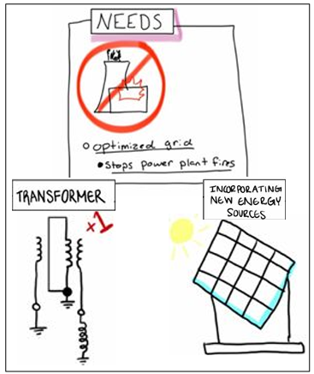
Users & Needs
Users:
Iowa State Utilities
Power Consumers on Campus
Needs:
Reliability & Resilience
Adaptability to Renewables
Safety & Compliance
Cost-Effective Upgrades
Future Readiness
Notes:
MacKenzie

Slide 10
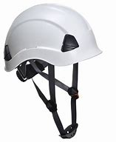
Constraints
Land Availability:
Designs we produce must lie within the physical boundaries of land owned by the university
Safety:
Ensure all designs meet proper safety standards
We must maintain proper electrical clearance for different components and adhere to NESC and SEC guidelines
Utility Information
Electrical utility information, even campus utilities, is proprietary
Lack of access to information regarding physical locations and device specifications
Notes:
Bethany

Slide 11
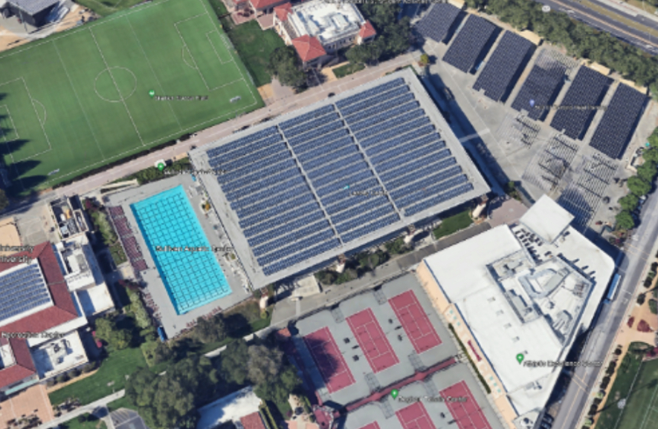
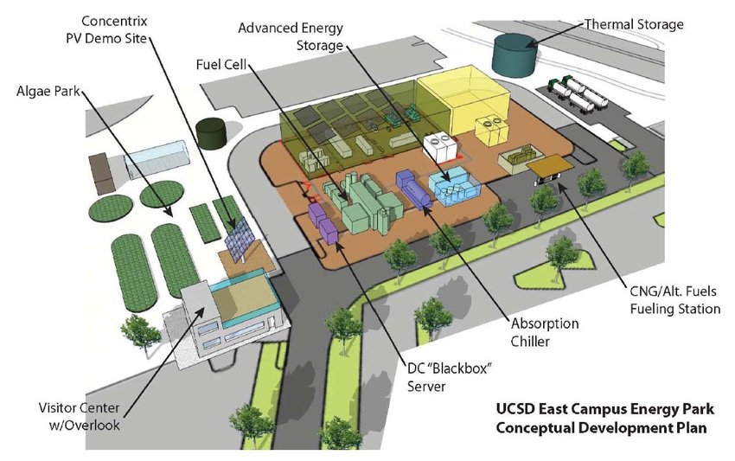
Market Research
Key Characteristics of Related Projects
Fewer emissions than conventional gas plants (UC San Diego)
Self-sufficient generation, independent from grid (MIT)
Enhanced reliability with smart switches & underground cables (IIT)
Synchronous market operations (Princeton)
“Smart” microgrid reduces costs by 20% (Santa Clara)
Market Gap:
Mixed Energy Sources: Combine to reduce carbon emissions
Space Efficiency: Utilize compact renewable systems
Resilience & Scalability: Design systems that operate through outages and can adapt with load growth
Notes:
MacKenzie

Slide 12
Conceptual Design - Substation
Notes:
Sean

Slide 13
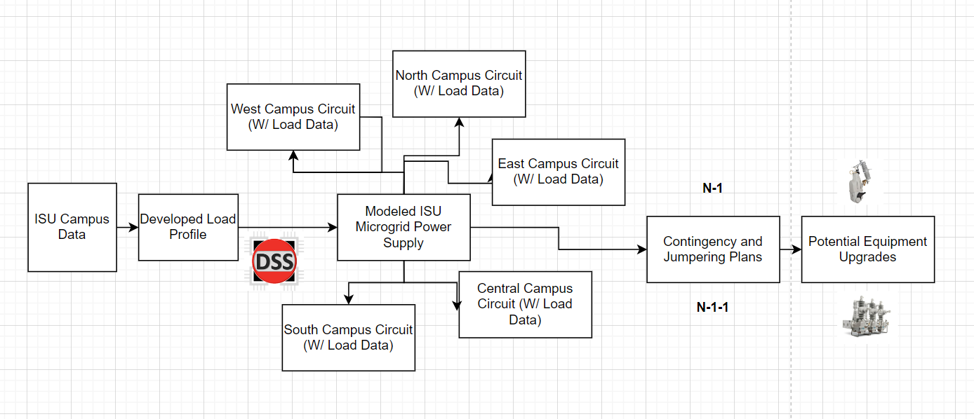
Conceptual Design - Distribution
Notes:
Bethany

Slide 14
Resources & Cost
Software/Hardware Needed | Cost
OpenDSS | Free - Open source software
AutoCAD Electrical | Free - included in ISU Softwares
Microsoft Excel | Free - included in ISU Softwares
BlueBeam | Free - included in ISU Softwares
Notes:
Mina K.

Slide 15
Gantt Chart & Project Timeline Substation
Notes:
Mina K.

Slide 16
Gantt Chart & Project Timeline Distribution
Notes:
Nathan

Slide 17
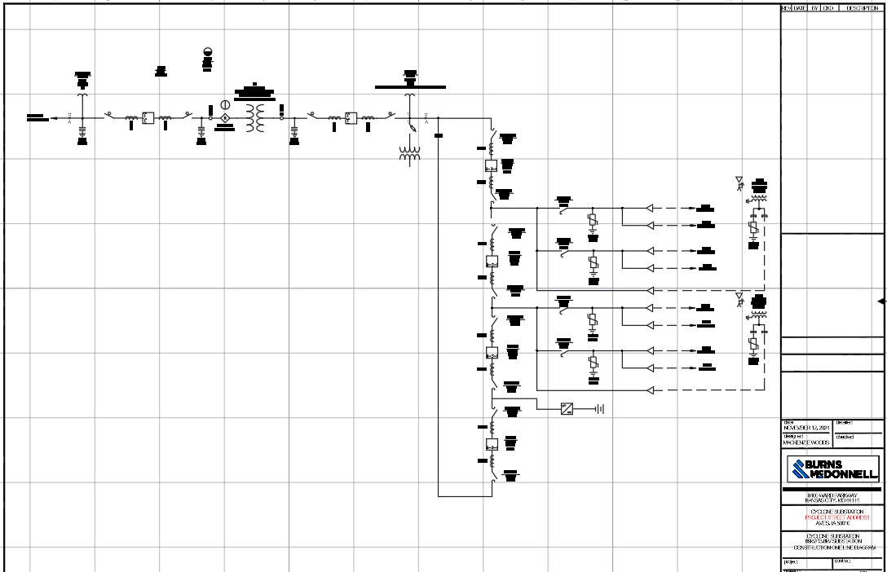
Detailed Design - Substation
Notes:
MacKenzie

Slide 18
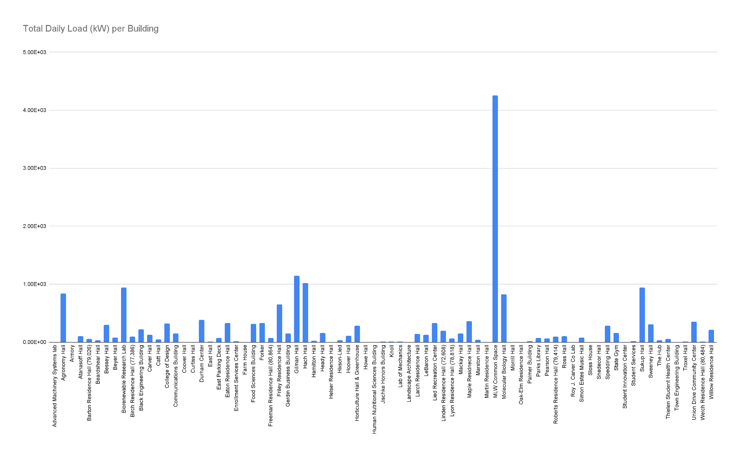
Detailed Design - Distribution
Notes:
Bethany

Slide 19
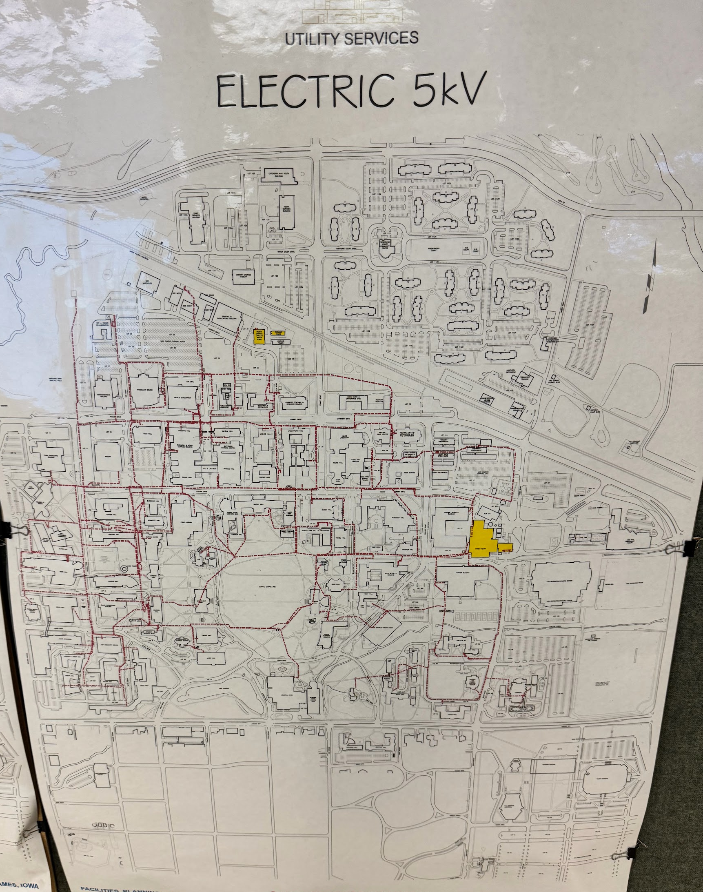
Detailed Design - Electrical System
Power Sources:
Generated at Power Plant or purchased
Underground Distribution System:
Distributed through more than 25 miles of medium voltage cables in steels conduits within concrete duct banks
Substations:
Includes transformers and/or switchgear
Voltage Distribution
Electricity supplied: 13,800V or 4,160V
Over 500 building transformers to manage voltage
Reduce voltage to 480V, 208V, and/or 120V
Notes:
Thomas

Slide 20
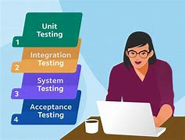
Testing Plan Overview
Substation:
Relay Protection Logic - Unit Testing
Control Systems - Unit Testing
Simulate fault currents - Interface Testing
Ensure components of the substation properly interact with each other - Integration Testing
Comply with all regulations and requirements - Acceptance Testing
Distribution:
Distribution Protection and Communication - Unit Testing
Ensure communication flow between devices - Integration Testing
Confirm components are functional and operational - System Testing
Ensure compatibility with substation and distribution systems - Regression Testing
Notes:
MacKenzie

Slide 21
Current Status
Substation Team Status:
Rev I: One-Line Diagram
Rev I: Relay Functional
Rev 0: BOM
Rev 0: General Arrangement (GA)
Distribution Team Status:
Load Profile Data: Completed
Data Analysis: In-Progress
Distribution Model: In-Progress
Notes:
Sean and Nathan

Slide 22
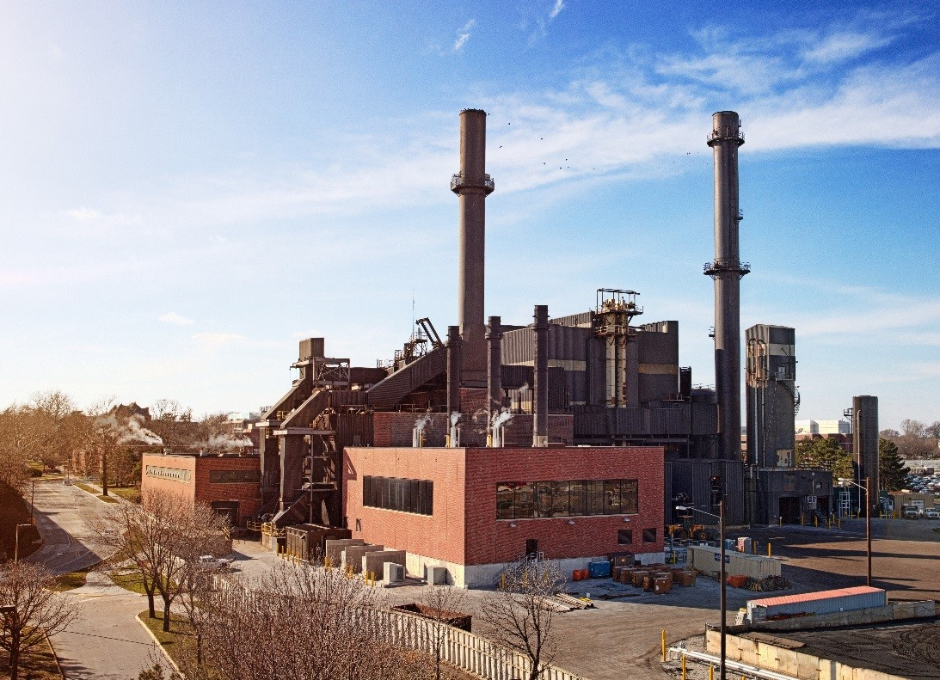
Conclusion
Scope:
Upgrade ISU's microgrid and implement a new substation to improve reliability, support future growth, while also integrating renewable energy sources.
Impact:
Supports future campus growth while aligning with ISU’s sustainability and improve fault protection and
system resilience.
Notes:
Mina K.

Slide 23
Next Semester Plan - Substation
Notes:
Mina K.

Slide 24
Next Semester Plan - Distribution
Task | Completion Date
Finalization of model development in OpenDSS | 1/31/2025
Contingency & Jumpering Plans | 2/28/2025
Protection Coordination Studies, Additional Resources | 4/31/2025
Notes:
Thomas

Slide 25
Questions?
Notes:
Thomas

